Slide 1
All For Love
John Dryden
Presented by:
Jaspal Kaur Matharu
Guest Faculty
Department of English
Gangadhar Meher University

Slide 2
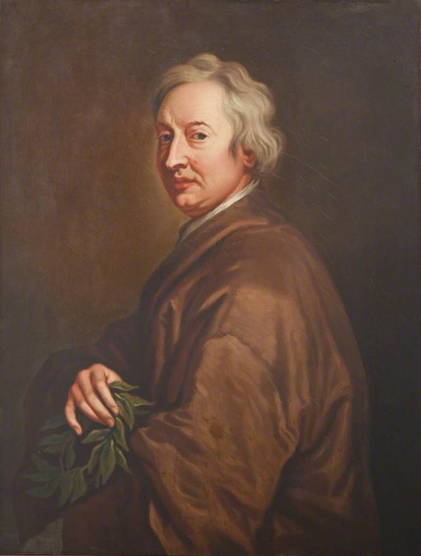
John Dryden
John Dryden, (born August 9, 1631- died May 1, 1700), English poet, dramatist, and literary critic who so dominated the literary scene of his day that it came to be known as the Age of Dryden. Romanticist writer Sir Walter Scott called him "Glorious John".
Famous Works:
Absalom and Achitophel (1681)
Mac Flecknoe (1682)
The Medall (1682)
Don Sebastian (1690)

Slide 3
All For Love
Or
The World Well Lost
All for Love or, the World Well Lost (1677), is a heroic drama by John Dryden. It is Dryden's best-known and most performed play. It is a tragedy written in blank verse and is an attempt on Dryden's part to reinvigorate serious drama. It is an acknowledged imitation of Shakespeare's Antony and Cleopatra. The play focuses on the last hours of the lives of its hero and heroine.
Heroic Drama:
Heroic drama, also known as heroic tragedy was a popular literary form during the restoration period. Heroic drama had larger than life heroes and heroines, highly rhetorical dialogue and exotic locales. Like heroic poems or epics, it was written in heroic couplets.

Slide 4
Characters
Antony
Cleopatra
Ventidius
Dollabella
Alexas
Octavius
Octavia
Charmion
Serapion
Iras
Myris
Agrippina and Antonia

Slide 5
Plot
Antony and Octavius have defeated Julius Caesar, and now Octavius is the new caesar (the ruler of Rome). Antony is married to Octavia, Octavius's sister, and the couple has children together. However, Antony has abandoned his family and has been living in Egypt with his mistress, Cleopatra. Vowing to take revenge on Antony, Octavius Caesar has laid siege to Alexandria.
As the play opens, Serapion, a priest, is describing several foreboding omens he has witnessed when Alexas, the eunuch servant of Cleopatra, enters. Alexas dismisses Serapion's talk of omens because he is more concerned with the state of his lady's relationship with Antony. Cleopatra dotes on Antony, but lately, he is depressed and distant, preoccupied with the looming threat of Octavius Caesar. Alexas fears Antony will leave Cleopatra.
Antony is visited by Ventidius, a Roman knight and an old acquaintance of Antony. Afraid that Ventidius will persuade Antony to return to Rome, Alexas announces that the Egyptians will be throwing an extravagant party in honor of Antony's birthday. Ventidius disapproves and scolds Antony, saying that Cleopatra "has quite unmanned him." Antony will not hear anything against Cleopatra, but when Ventidius offers him ten thousand soldiers with which to fight Octavius in exchange for leaving Cleopatra, Antony agrees.

Slide 6
When Cleopatra hears the news, she goes to see Antony and brings gifts for his soldiers. Antony blames her, saying that if he had never fallen in love with her, he would still be safe in Rome with his family. He also reminds her that she is the former mistress of Octavius Caesar, though he still deigned to take her as his own mistress. Cleopatra defends herself, saying that while Octavius may have had her body, Antony holds her heart. She shows him a letter from Octavius. In the letter, Octavius offers to spare Cleopatra's life if she will betray Antony. When Antony sees that she has refused the offer, he and Cleopatra reconcile, much to Ventidius's dismay.
Antony is visited by Dolabella, another former friend from Rome. They have been on bad terms because Dolabella is also in love with Cleopatra. Together, Ventidius and Dolabella try to persuade Antony to return to Rome, but he refuses, so Dolabella brings out his hidden weapon: he has brought Octavia and the children to Egypt. Under the influence of his family and his old friends, Antony agrees to leave Cleopatra.
As Alexas is informing Cleopatra of this news, Octavia enters. The women argue, but Octavia maintains that Antony belongs by her side even if he loves her less than he loves Cleopatra. When Octavia leaves, Cleopatra fears she has lost Antony for good. Dolabella arrives bearing Antony's farewell to Cleopatra. Antony feared that if he said goodbye in person, he would lose his resolve and be persuaded to stay. With Alexas's help, Dolabella and Cleopatra trick Antony into believing they have become lovers in order to make him jealous.

Slide 7
When Ventidius and Octavia hear that Dolabella and Cleopatra have become lovers, they share the news with Antony to convince him that he has made the right decision to leave. Antony, however, refusing to believe it, asks Alexas about it. When Alexas confirms the story, Antony becomes enraged. He visits Cleopatra and Dolabella, who proclaim their innocence, but Antony will not believe them.
When she sees Antony's jealous rage over Cleopatra, Octavia takes their children and returns to Octavius, abandoning her attempt at reconciliation. Antony climbs a tower to watch the battle between the Egyptian and Roman naval fleets, but to his horror, he sees the fleets join forces. He believes Cleopatra has sold him out to Octavius.
When she sees Antony's jealous rage over Cleopatra, Octavia takes their children and returns to Octavius, abandoning her attempt at reconciliation. Antony climbs a tower to watch the battle between the Egyptian and Roman naval fleets, but to his horror, he sees the fleets join forces. He believes Cleopatra has sold him out to Octavius.

Slide 8
Themes
Honor versus Love
Passion versus Reason
Authority versus Freedom
Power
Jealousy
Duty
Death

Slide 9
Critical View
According to Dr.Johnson, All for Love "has one fault equal to many, though rather moral than critical, that by admitting the romantic omnipotence of love, Dryden has recommended as laudable and worthy of imitation that conduct which, through all ages, the good have censured as vicious and the bad have despised as foolish." Dr. Johnson's comment, with its awareness that Dryden was recommending neither the values of conventional marriage nor the reckless indulgence in the pleasures of the flesh, is one of the best interpretations of the play.

